Slide 1
Machine Learning Project 1
By Ben Kaisharis and Luke Roe

Slide 2
Evaluating Clustering Metrics

Slide 3
Imports
import numpy as np
import pandas as pd
from sklearn import datasets
from sklearn.cluster import KMeans, DBSCAN, OPTICS
from sklearn.metrics import silhouette_score, v_measure_score, adjusted_rand_score, normalized_mutual_info_score, adjusted_mutual_info_score
from sklearn.preprocessing import StandardScaler, MinMaxScaler, RobustScaler, MaxAbsScaler
from scipy.cluster.hierarchy import linkage, fcluster
import hdbscan

Slide 4
Import Data
iris = datasets.load_iris()
X_iris = iris.data
y_iris = iris.target
breast = pd.read_csv('project1/breast_wisc_dataset.csv', header=0)
X_breast_wisc = breast.iloc[:, :-1]
y_breast_wisc = breast.iloc[:, -1]
print(y_breast_wisc)
cybersecurity = pd.read_csv('project1/cybersecurity_data.csv', header=0)
X_cybersecurity = cybersecurity.iloc[:, :-1]
y_cybersecurity = cybersecurity.iloc[:, -1]
aapl = pd.read_csv('project1/HFT_AAPL_data.csv', header=0)
aapl = aapl.drop(columns=['Date'])
aapl = aapl.drop(columns=[aapl.columns[0]])
X_aapl = aapl.iloc[:, 1:]
y_aapl = aapl.iloc[:, 0]

Slide 5
Scaling Functions
def SSScaleData(X):
scaler = StandardScaler()
X = scaler.fit_transform(X)
return X
def MMScaleData(X):
scaler = MinMaxScaler()
X = scaler.fit_transform(X)
return X

Slide 6
Scaling Functions
def RBScaleData(X):
scaler = RobustScaler()
X = scaler.fit_transform(X)
return X
def MAScaleData(X):
scaler = MaxAbsScaler()
X = scaler.fit_transform(X)
return X

Slide 7
Clustering Functions
def do_kmeans(X, k):
kmeans = KMeans(n_clusters=k, random_state=0)
kmeans.fit(X)
y_pred = kmeans.predict(X)
return y_pred
def do_bisecting_kmeans(X, k):
Z = linkage(X, 'ward')
y_pred = fcluster(Z, k, criterion='maxclust')
return y_pred

Slide 8
Clustering Functions (cont.)
def do_hdbscan(X, min_cluster_size):
clusterer = hdbscan.HDBSCAN(min_cluster_size=min_cluster_size)
clusterer.fit(X)
y_pred = clusterer.labels_
return y_pred
def do_dbscan(X, eps, min_samples):
dbscan = DBSCAN(eps=eps, min_samples=min_samples)
dbscan.fit(X)
y_pred = dbscan.labels_
return y_pred
def do_optics(X, min_samples, xi):
optics = OPTICS(min_samples=min_samples, xi=xi)
optics.fit(X)
y_pred = optics.labels_
return y_pred

Slide 9
Scaling Data
X_aapl_scaled_ss = SSScaleData(X_aapl)
X_aapl_scaled_mm = MMScaleData(X_aapl)
X_aapl_scaled_rb = RBScaleData(X_aapl)
X_aapl_scaled_ma = MAScaleData(X_aapl)
X_iris_scaled_ss = SSScaleData(X_iris)
X_iris_scaled_mm = MMScaleData(X_iris)
X_iris_scaled_rb = RBScaleData(X_iris)
X_iris_scaled_ma = MAScaleData(X_iris)

Slide 10
Scaling Data
X_cybersecurity_scaled_ss = SSScaleData(X_cybersecurity)
X_cybersecurity_scaled_mm = MMScaleData(X_cybersecurity)
X_cybersecurity_scaled_rb = RBScaleData(X_cybersecurity)
X_cybersecurity_scaled_ma = MAScaleData(X_cybersecurity)

Slide 11
Evaluation Function
def evaluate_clustering(X, labels_true, labels_pred):
unique_labels = np.unique(labels_pred)
if len(unique_labels) > 1:
silhouette = silhouette_score(X, labels_pred)
v_measure = v_measure_score(labels_true, labels_pred)
ari = adjusted_rand_score(labels_true, labels_pred)
nmi = normalized_mutual_info_score(labels_true, labels_pred)
ami = adjusted_mutual_info_score(labels_true, labels_pred)
return silhouette, v_measure, ari, nmi, ami
else:
print("Not enough clusters to evaluate. Found labels:", unique_labels)
return None, None, None, None, None

Slide 12
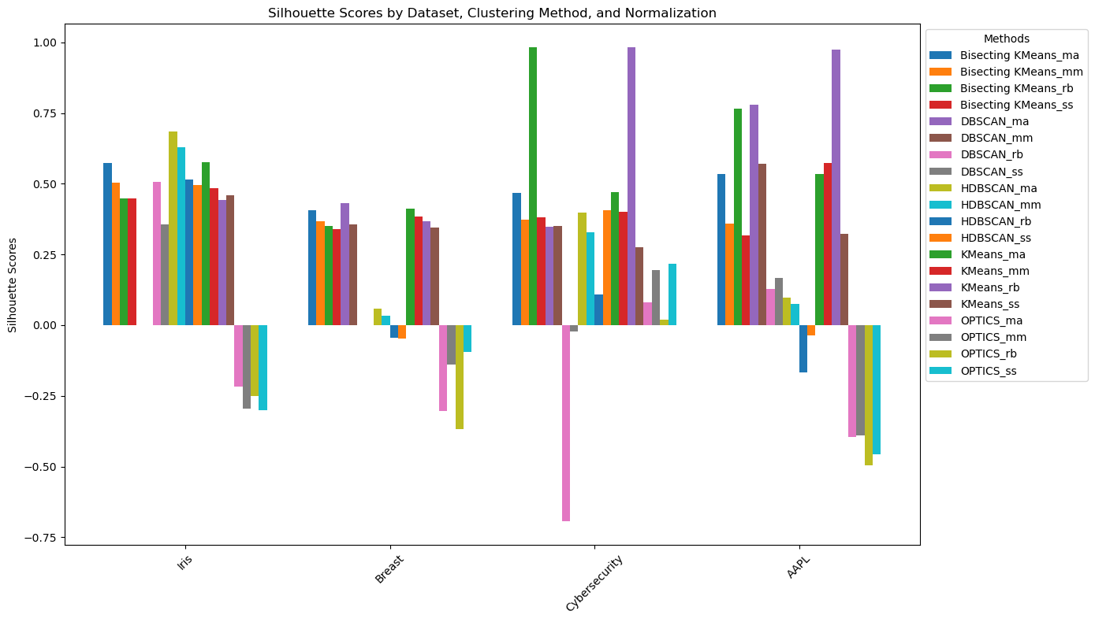
Evaluating Silhouette Scores

Slide 13
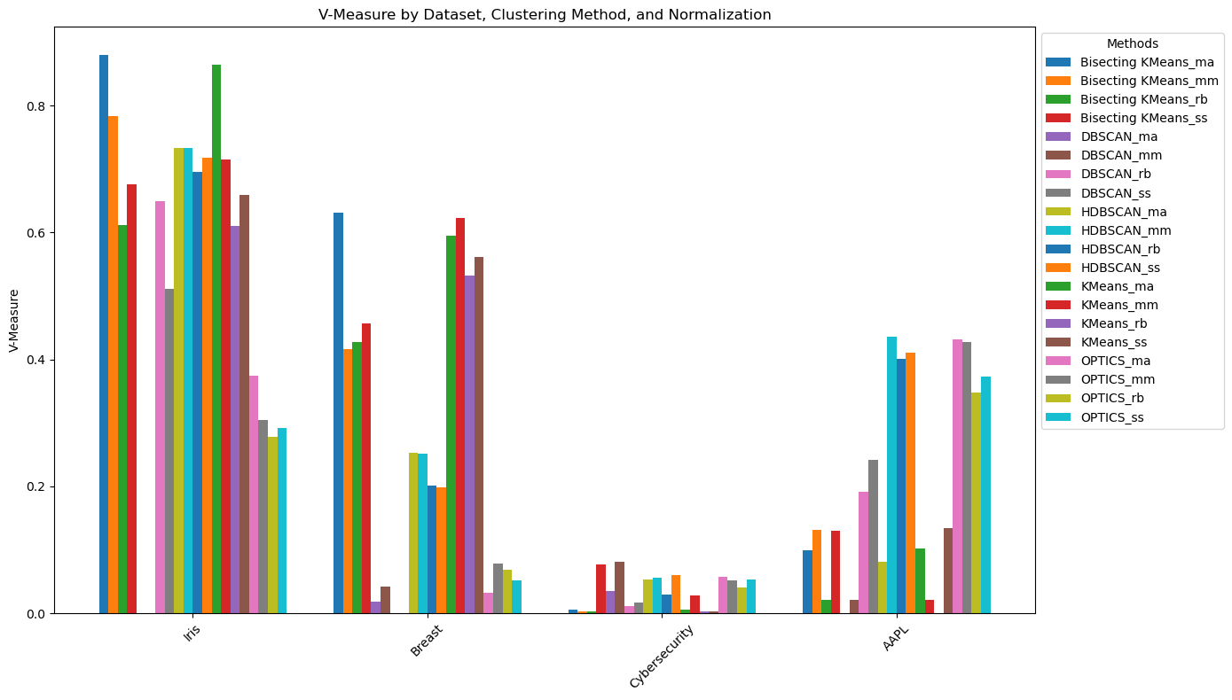
Evaluating V-Measure

Slide 14
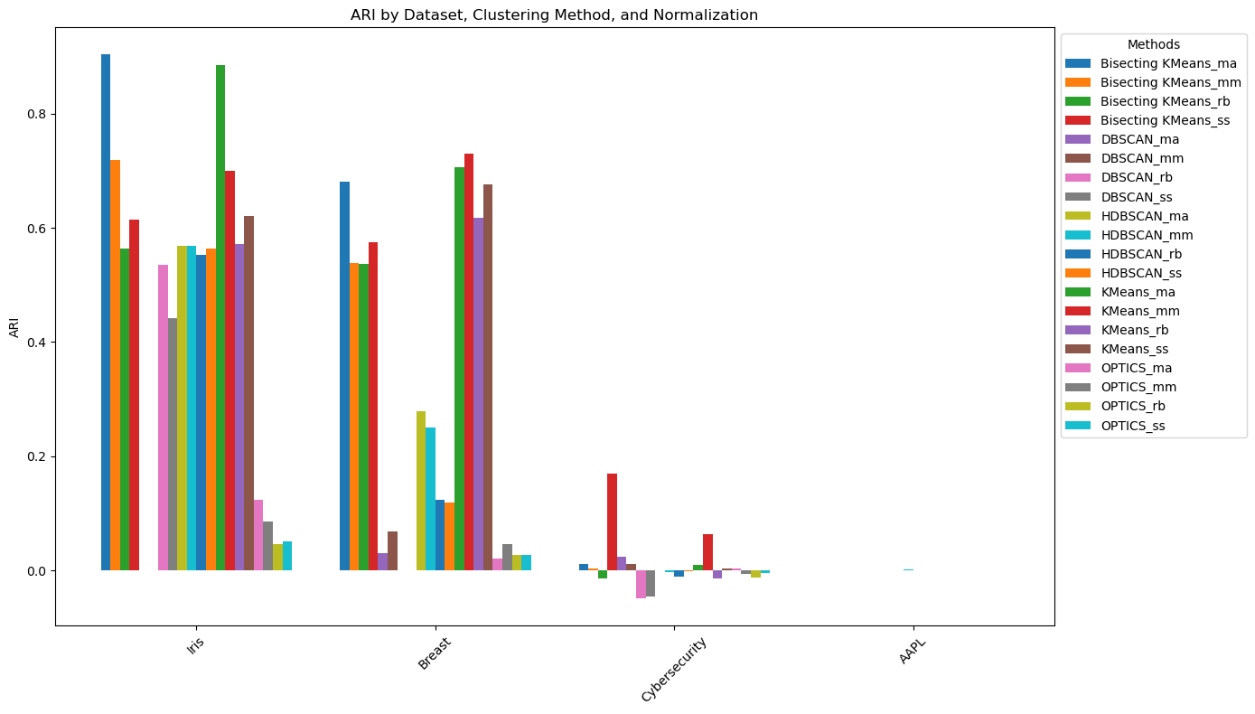
Evaluating ARI

Slide 15

Evaluating NMI

Slide 16
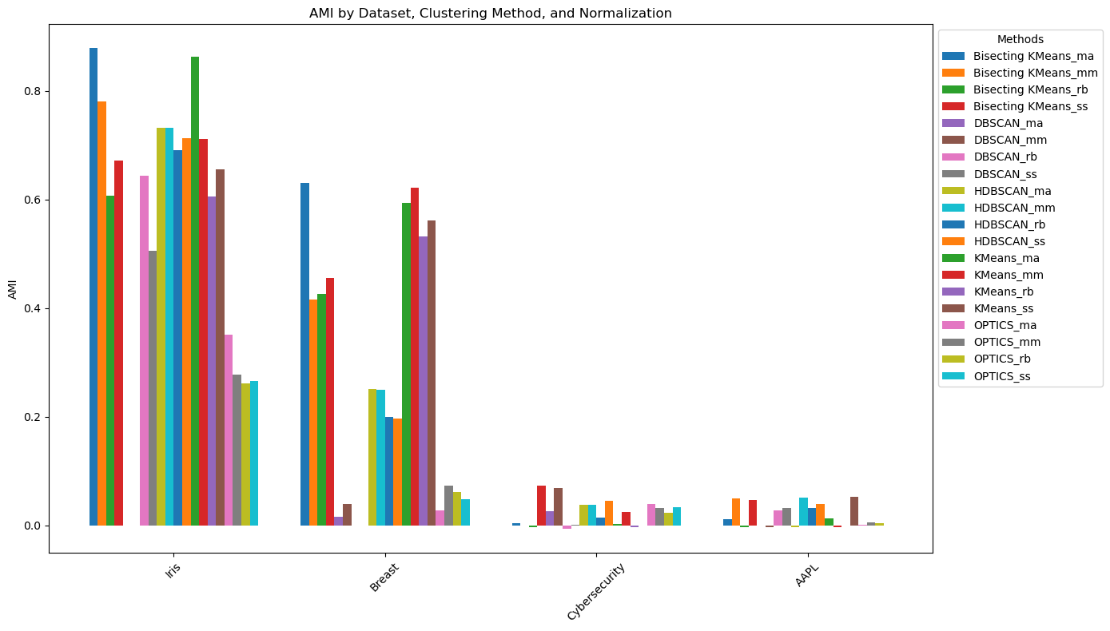
Evaluating AMI

Slide 17
Conclusions
OPTICS performs poor silhouette scores
Cybersecurity has low v-measure
We have very different AMI between iris and breast cancer data and the cybersecurity and high frequency trading data, probably due to scaling of the datasets

Slide 18
YellowBrick

Slide 19
What is Yellowbrick?
Yellowbrick is powerful machine learning tool that can be used to create various visualizations for analysis and presentation
It provides an easier way to select models as well as show feature importance
It works in conjunction with Scikit Learn as well as uses MatPlotLib for its visualization

Slide 20
Why Yellowbrick is Important
Yellowbrick provides a streamlined way model evaluation and feature selection
It presents complex models in an intuitive way where it becomes easier to view model strengths and weaknesses
It also assesses model effectiveness as well as points of optimization

Slide 21
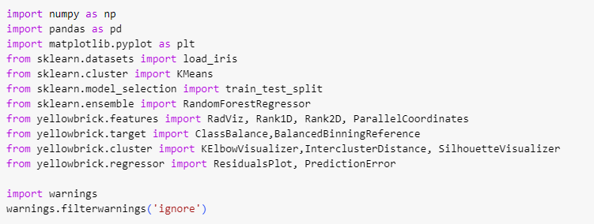
Imports

Slide 22
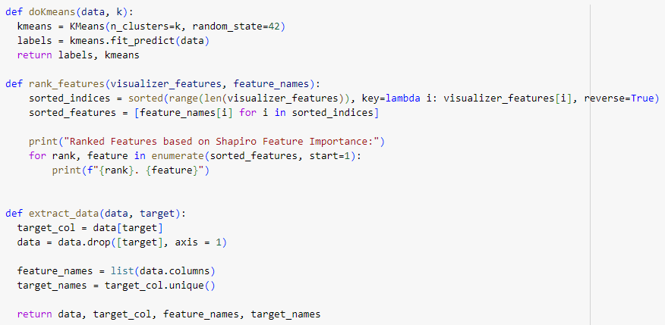
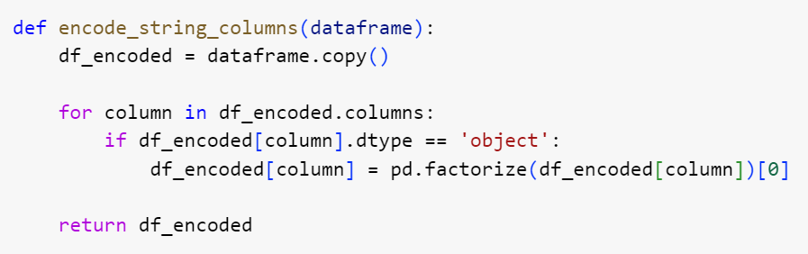
Functions

Slide 23
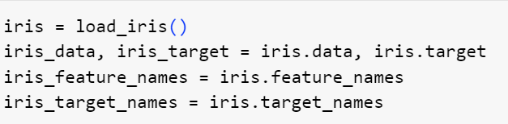
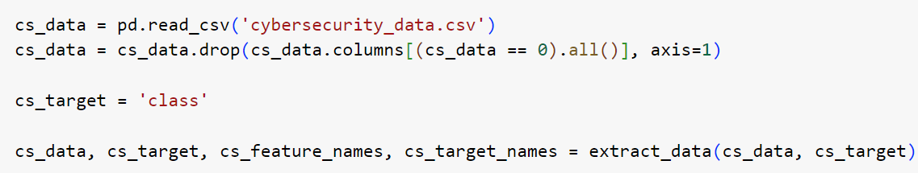
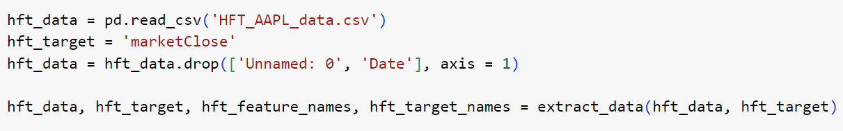
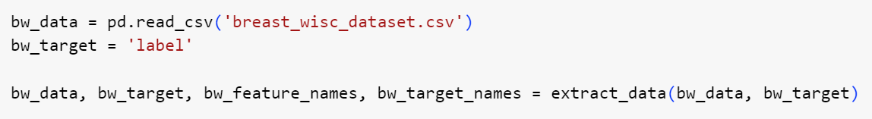
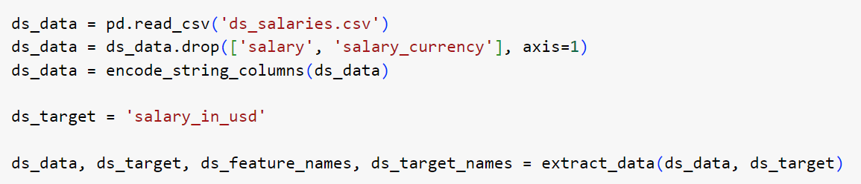
Data Import and Cleaning

Slide 24
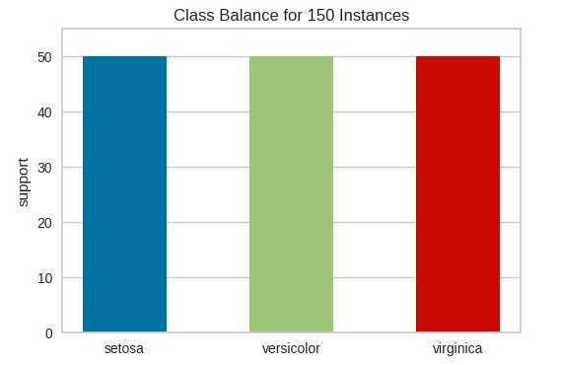
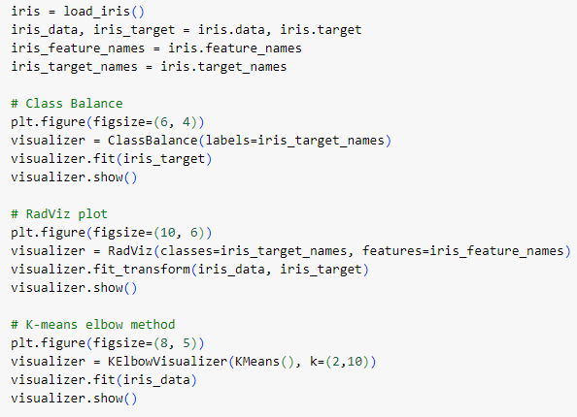
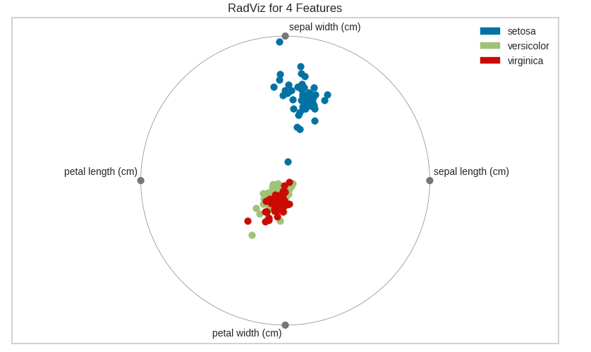
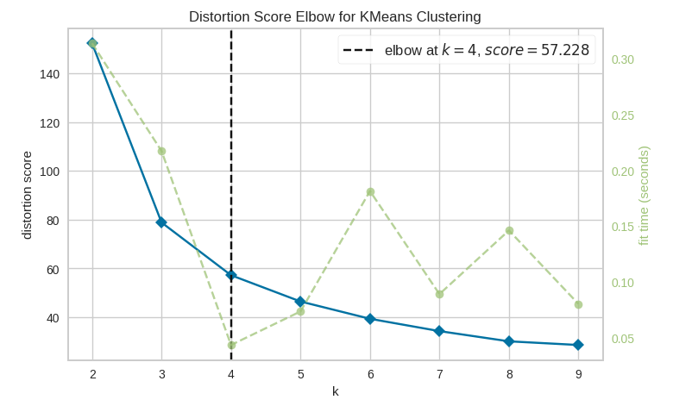
Iris Dataset Pre-Clustering YellowBrick Plots

Slide 25
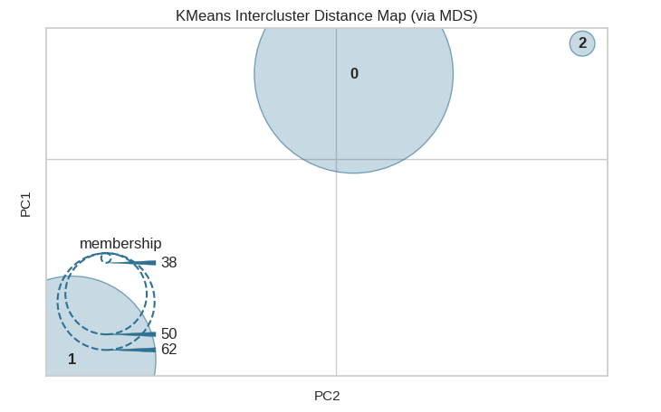
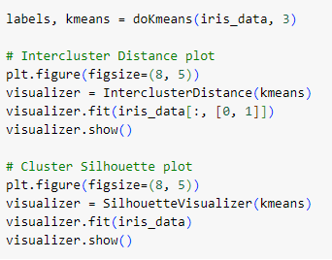
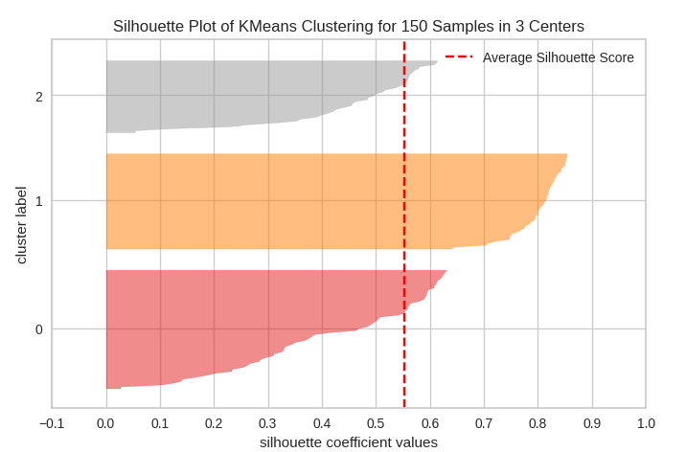
Iris Dataset Post-Clustering Plots

Slide 26
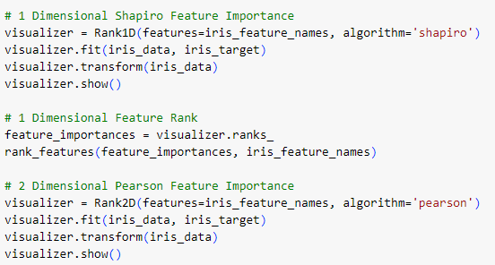
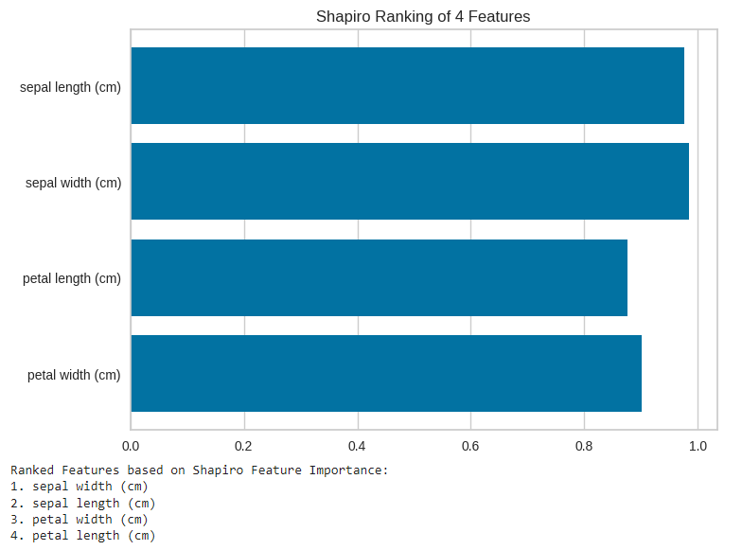
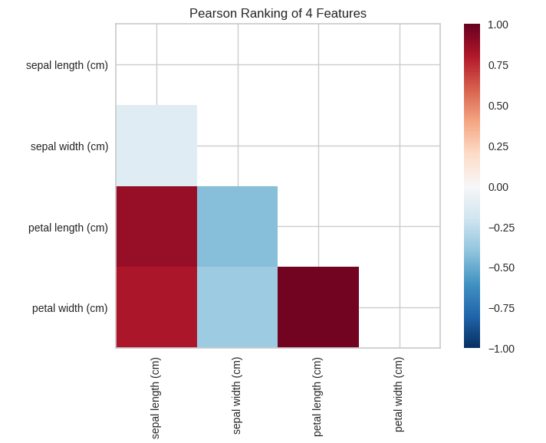
Iris Dataset Feature Ranking

Slide 27
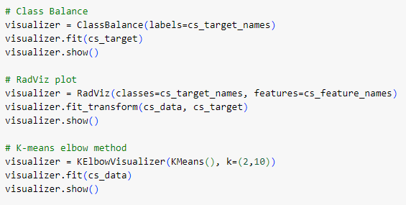
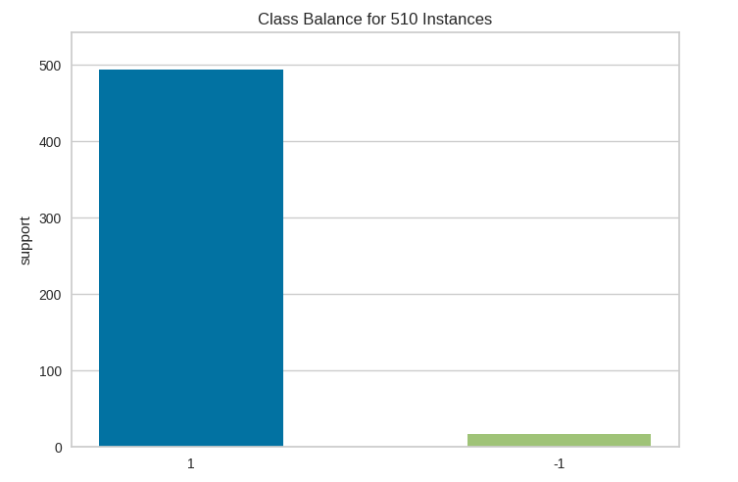
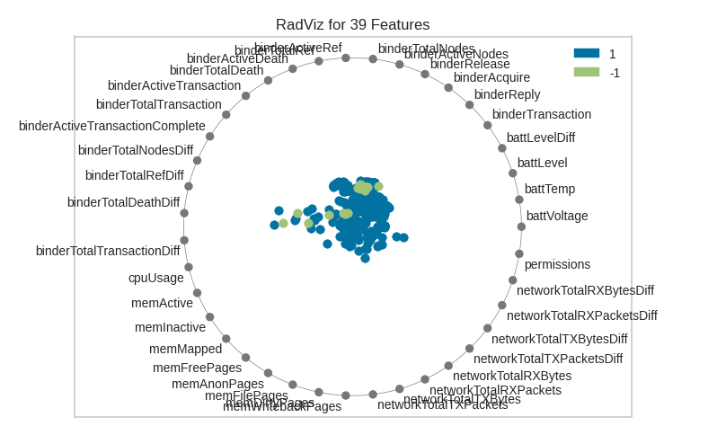
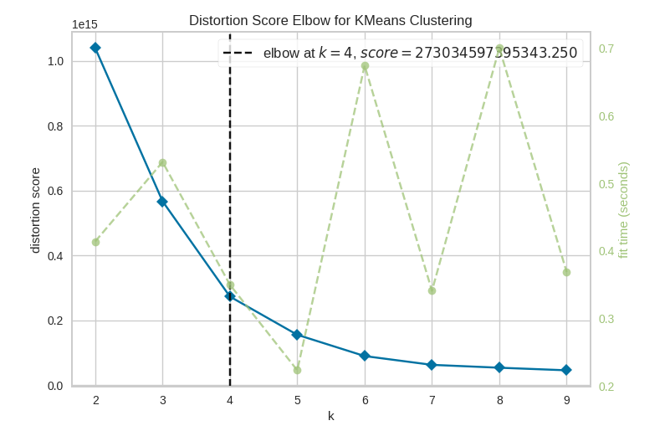
Cybersecurity Dataset Pre-Clustering YellowBrick Plots

Slide 28
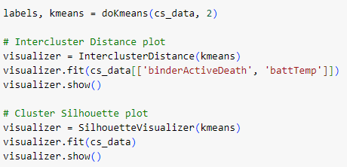
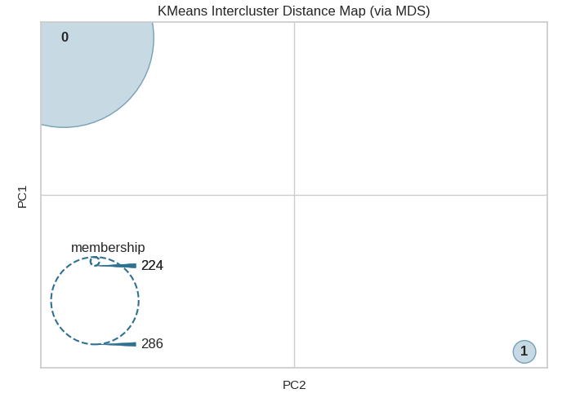
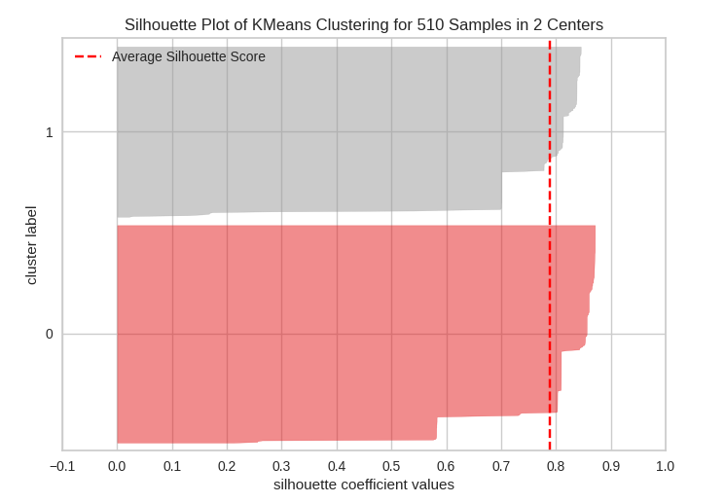
Cybersecurity Dataset Post-Clustering Plots

Slide 29
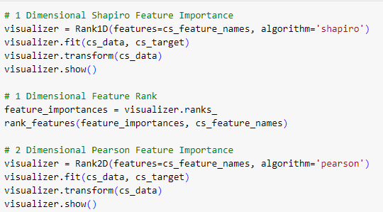
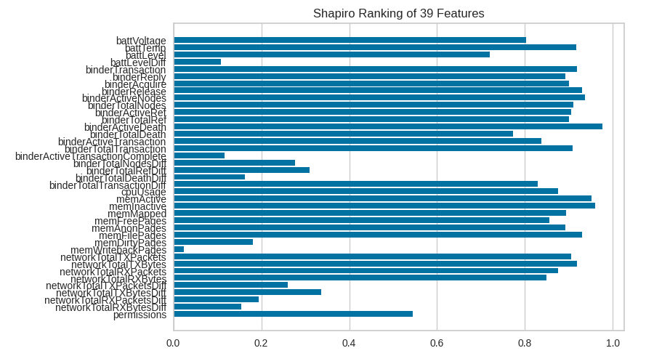
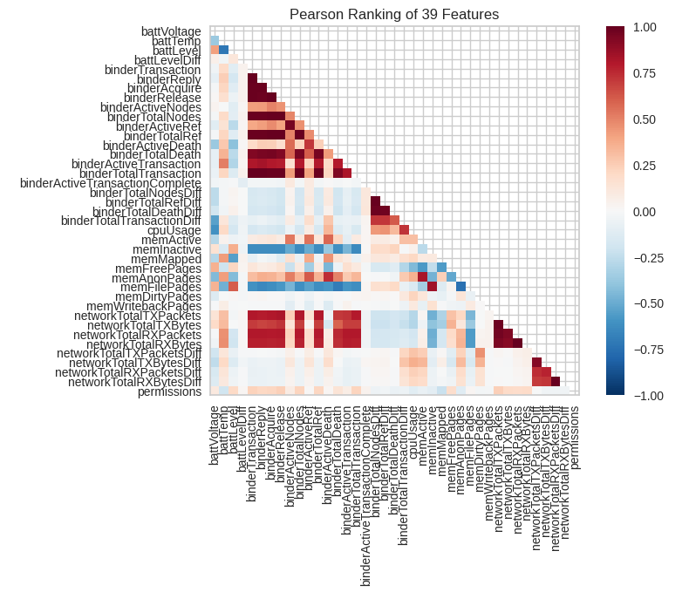
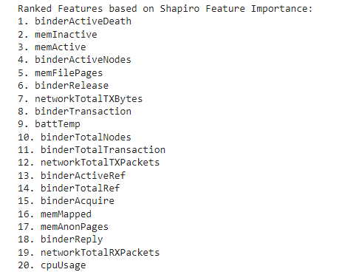
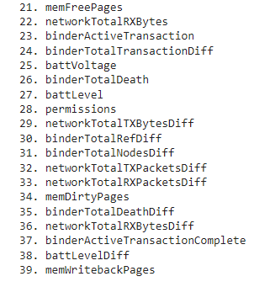
Cybersecurity Dataset Feature Ranking

Slide 30
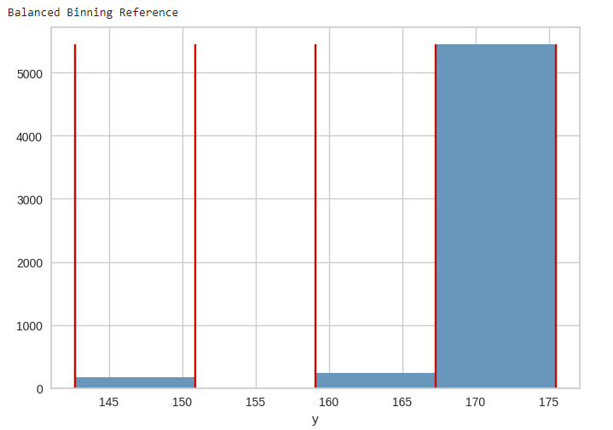
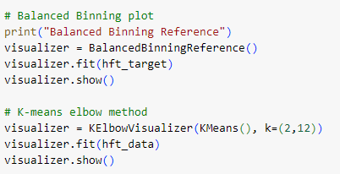
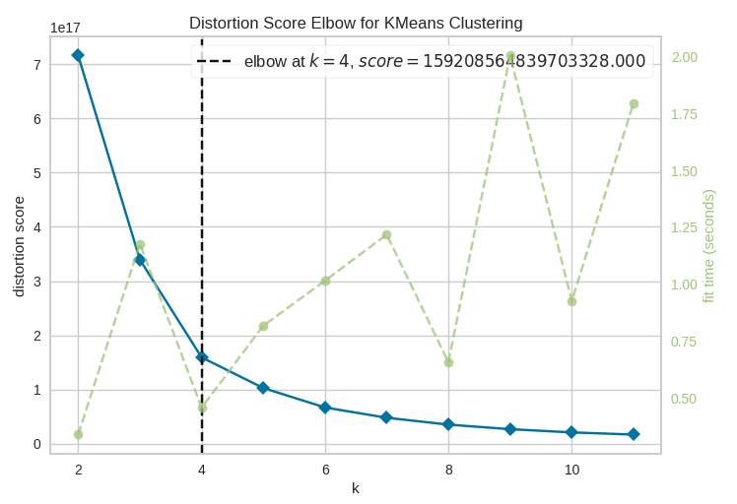
HFT AAPL Dataset Pre-Clustering YellowBrick Plots

Slide 31
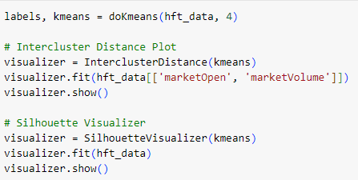
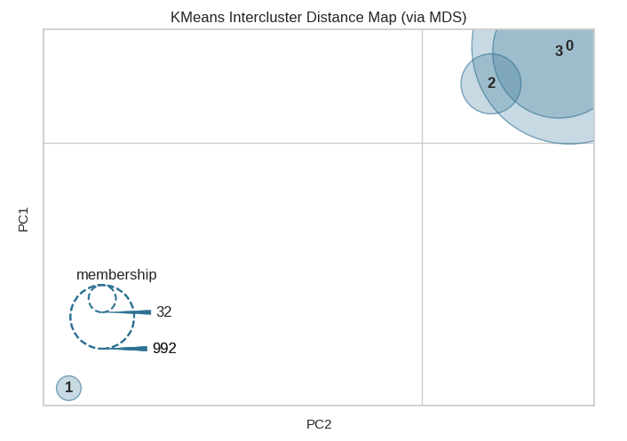
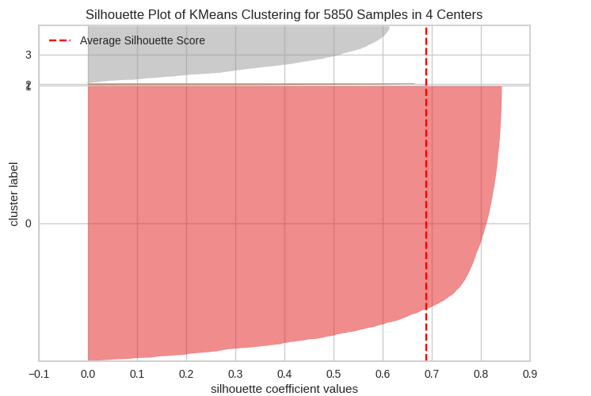
HFT AAPL Dataset Post-Clustering Plots

Slide 32
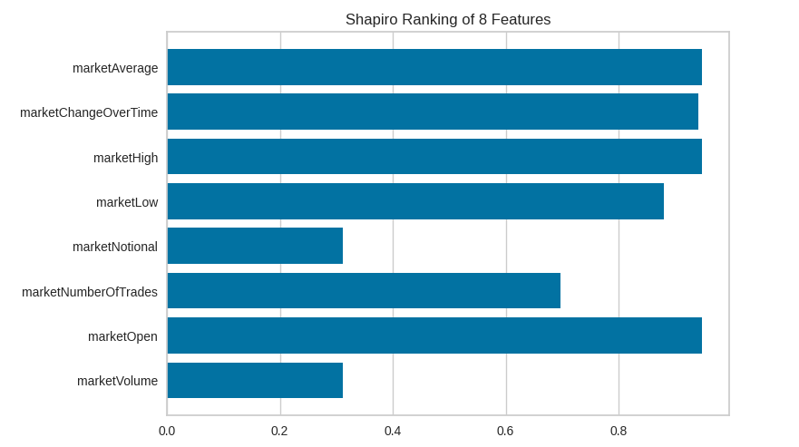
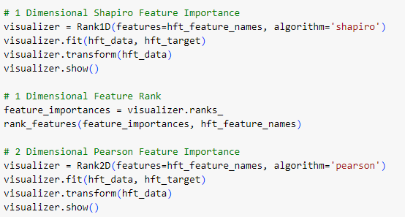
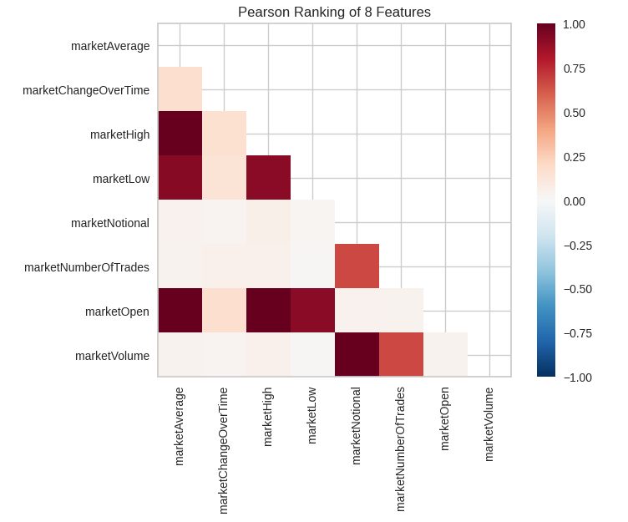
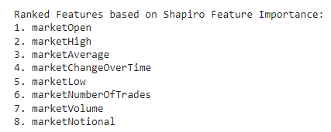
HFT AAPL Dataset Feature Ranking

Slide 33
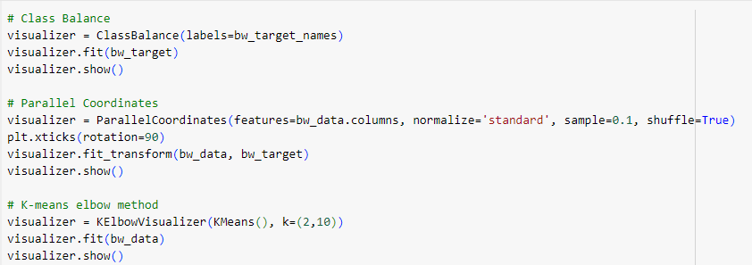
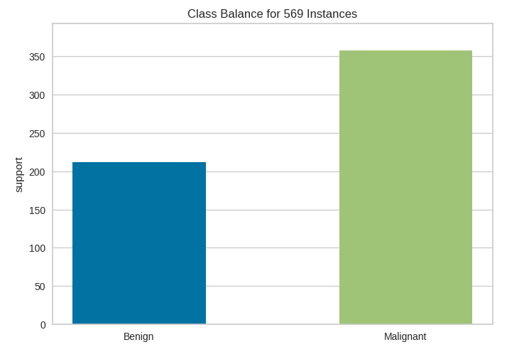
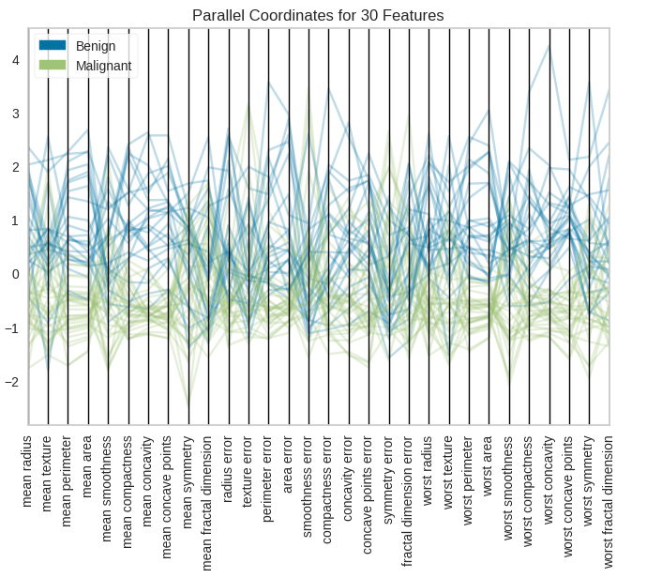
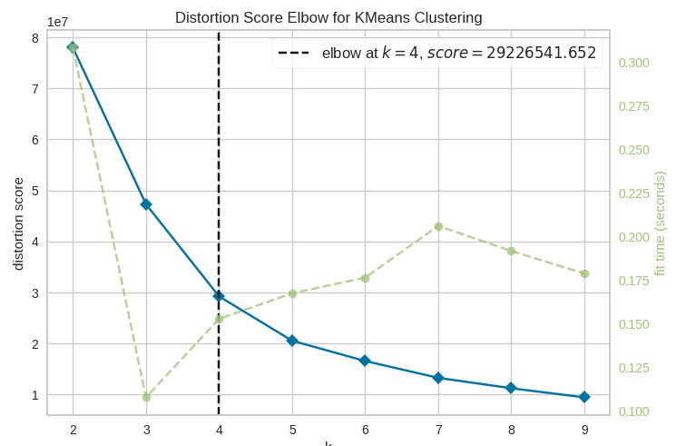
Breast Wisc Dataset Pre-Clustering YellowBrick Plots

Slide 34
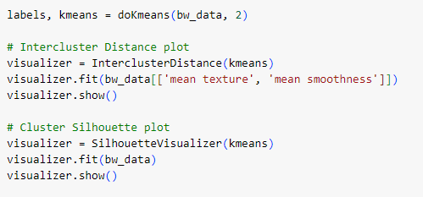
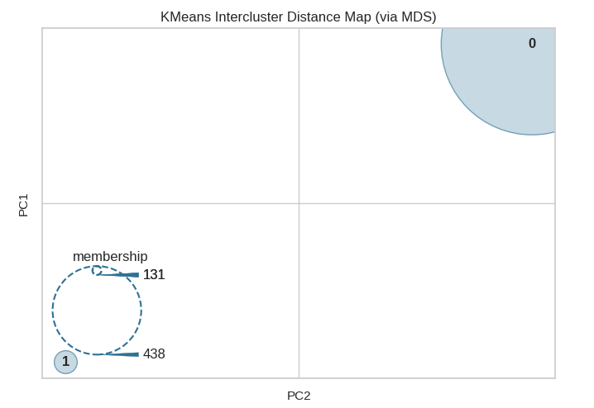

Breast Wisc Dataset Post-Clustering Plots

Slide 35





Breast Wisc Dataset Feature Ranking

Slide 36
Chosen Dataset
The dataset that we chose is the Data Science Salaries 2023 dataset from Kaggle which can be used to show how different aspects of a data scientists career influences their salary
We decided to fit this dataset into a Linear Regression model using Random Forests which works well with the quantitative target variable of ‘salary_in_usd’

Slide 37



Data Science Salary Dataset Regression Plots

Slide 38




Data Science Salary Dataset Feature Ranking

Slide 39
Data Science Salaries Conclusions
The somewhat low R^2 values for the regression model could be attributed to multiple factors such as noisy data, size of data, or non-linearity in the dataset.
From the feature ranking, the features of ‘work_year’, ‘remote_ratio’, ‘experience_level’, and ‘job_title’ have a significantly higher value than that of the other features which shows their increased influence of the target variable of ‘salary_in_usd’

Slide 40
Overall Yellowbrick Conclusions
As you can see from the variety of visualization in the previous slides, Yellowbrick is a very powerful tool for data scientists, allowing for a streamlined way of model selection and feature importance
It also works very well with different Scikit-Learn machine learning algorithms such as K-Means and Linear Regression and provides easy visualization of the performance of these models as well as emphasizes points of improvement and optimization

